Slide 1
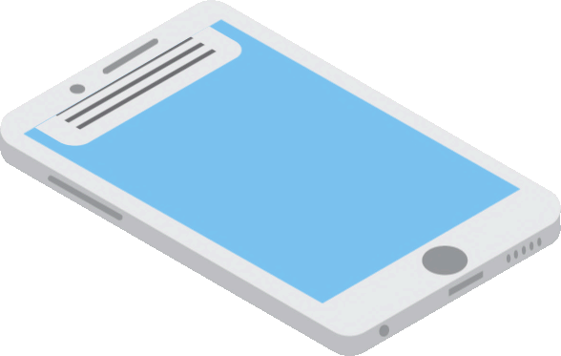
Mobile OS.

Slide 2


Today in presentation
Types of mobile operating system and its popularity
IOS and how Apple invented most popular os in the world
Android OS as opposition to Apple
we will learn about
IOS vs Android

Slide 3

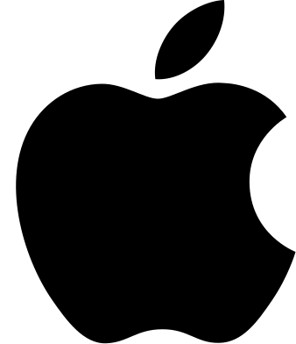


Types of mobile OS
Windows
0.1%
Apple
Android
IOS
39.8%
Produced by Apple and only for Apple
Answer to Apple with the biggest set of customisation.
Produced for a lot of very different models and different companies. Everyone can build up his own operating system based on android.
Can be used on phones, tablets, smart watches, smart glasses, etc.
Android
60%
Windows
Try to make a pocket computer

Slide 4
Types of mobile OS
Windows
0.1%
Android
Apple
Answer to Apple with the biggest set of customisation.
IOS
39.8%
IOS is a mobile operating system for Apple-manufactured devices. iOS runs on the iPhone, iPad, iPod Touch and Apple TV. iOS is best known for serving as the underlying software that allows iPhone users to interact with their phones using gestures such as swiping, tapping and pinching.
Android
60%
Windows
Try to make a pocket computer.

Slide 5
Types of mobile OS
Windows
0.1%
Android
Windows
Answer to Apple with the biggest set of customisation.
IOS
39.8%
Microsoft tried to take computer os and install it in phone.
Following the rise of newer smartphone OSs (iOS and Android) Windows Mobile never equalled the success and faded rapidly in the following years. By February 2010, Microsoft announced Windows Phone to supersede Windows Mobile with a more modern take on the industry. As a result, Windows Mobile has been deprecated. Windows Phone is incompatible with Windows Mobile devices and software.
Android
60%
Apple
Produced by Apple and only for Apple

Slide 6


IOS
iOS (formerly iPhone OS) is a mobile operating system created and developed by Apple Inc. Exclusively for its hardware.It is the operating system that powers many of the company's mobile devices, including the iPhone. It is the world's second-most widely installed mobile operating system, after Android. iOS devices come with preinstalled apps developed by Apple including Mail, Maps, TV, Music, FaceTime, Wallet, Health, and many more. Applications ("apps") are the most general form of application software that can be installed on iOS. They are downloaded from the official catalog of the App Store digital store, where apps are subjected to security checks before being made available to users. IOS applications can also be installed directly from an IPA file provided by the software distributor, via unofficial ways. They are written using iOS Software Development Kit (SDK) and, often, combined with Xcode, using officially supported programming languages, including Swift and Objective-C.

Slide 7

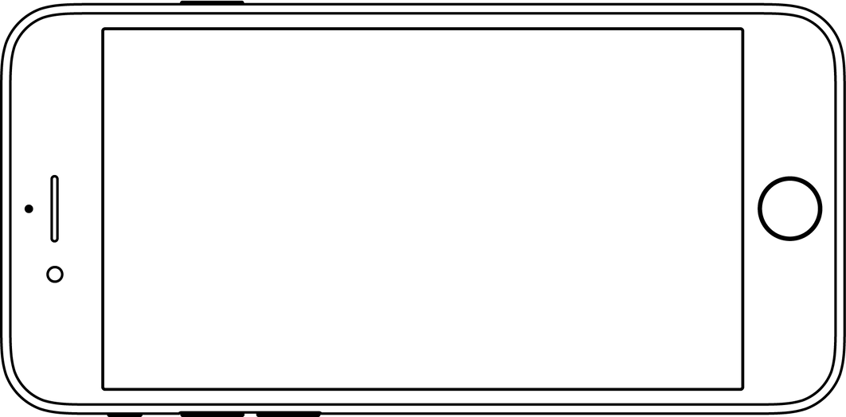
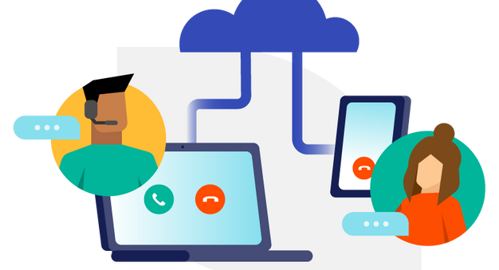

Voice Over Ip
Other companies have also created tools that allow for the development of native iOS apps using their respective programming languages. iOS offers various accessibility features to help users with vision and hearing disabilities. One major feature, VoiceOver, provides a voice reading information on the screen, including contextual buttons, icons, links and other user interface elements, and allows the user to navigate the operating system through gestures. Any apps with default controls and developed with a UIKit framework gets VoiceOver functionality built in. One example includes holding up the iPhone to take a photo, with VoiceOver describing the photo scenery. As part of a "Made for iPhone" program, introduced with the release of iOS 7 in 2013, Apple has developed technology to use Bluetooth and a special technology protocol to let compatible third-party equipment connect with iPhones and iPads for streaming audio directly to a user's ears.

Slide 8
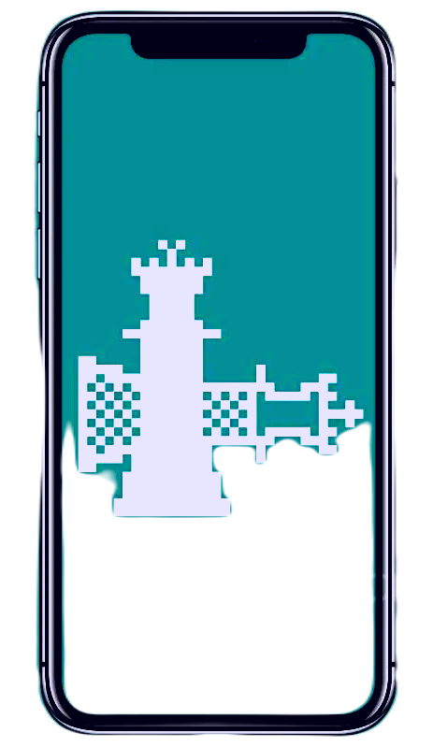
Jialbreak
Multitasking for iOS was first released in June 2010 along with the release of iOS 4. Before iOS 4, multitasking was limited to a selection of the applications Apple included on the device. Users could however "jailbreak" their device in order to unofficially multitask. Starting with iOS 4, on third-generation and newer iOS devices, multitasking is supported through seven background APIs;
• Background audio ,Voice over IP,Background location,Local notifications ,Task completion,Fast app switching,Newsstand, External Accessory

Slide 9

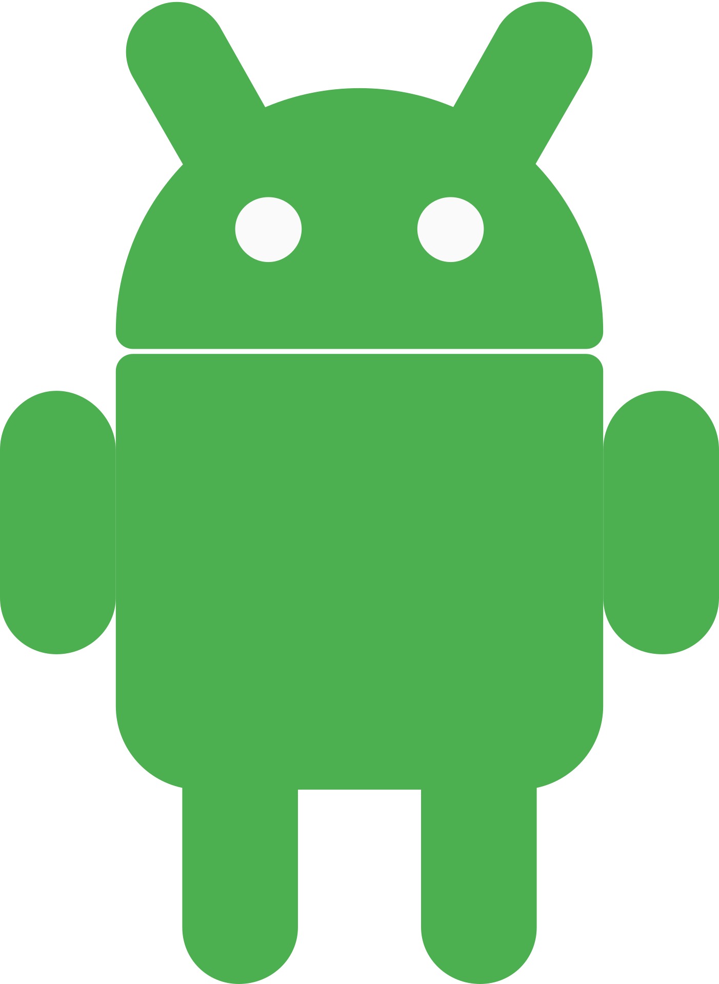

ANDROID
Android is a mobile operating system based on a modified version of the Linux kernel and other open source software, designed primarily for touchscreen mobile devices such as smartphones and tablets. Android is developed by a consortium of developers known as the Open Handset Alliance and commercially sponsored by Google. It was unveiled in November 2007, with the first commercial Android device, the HTC Dream, launched in September 2008.
Most versions of Android are proprietary. The core components are taken from the Android Open Source Project (AOSP), which is free and open-source software (FOSS) primarily licensed under the Apache License. When Android is installed on devices, the ability to modify the otherwise FOSS software is usually restricted, either by not providing the corresponding source code or preventing reinstallation through technical measures, rendering the installed version proprietary. Most Android devices ship with additional proprietary software pre-installed, most notably Google Mobile Services (GMS) which includes core apps such as Google Chrome, the digital distribution platform Google Play, and the associated Google Play Services development platform.

Slide 10




Google and Android ecosystem
Over 70 percent of Android smartphones run Google's ecosystem; some with vendor-customized user interface and software suite, such as TouchWiz and later One UI by Samsung, and HTC Sense. Competing Android ecosystems and forks include Fire OS (developed by Amazon), ColorOS by OPPO, OriginOS by vivo and MagicUI by Honor or custom ROM such as LineageOS. However, the "Android" name and logo are trademarks of Google which imposes standards to restrict the use of Android branding by "uncertified" devices outside their ecosystem.
The source code has been used to develop variants of Android on a range of other electronics, such as game consoles, digital cameras, portable media players, PCs, each with a specialized user interface. Some well known derivatives include Android TV for televisions and Wear OS for wearables, both developed by Google. Software packages on Android, which use the APK format, are generally distributed through proprietary application stores like Google Play Store, Amazon Appstore (including for Windows 11), Samsung Galaxy Store, Huawei AppGallery, Cafe Bazaar, and GetJar, or open source platforms like Aptoide or F-Droid.

Slide 11

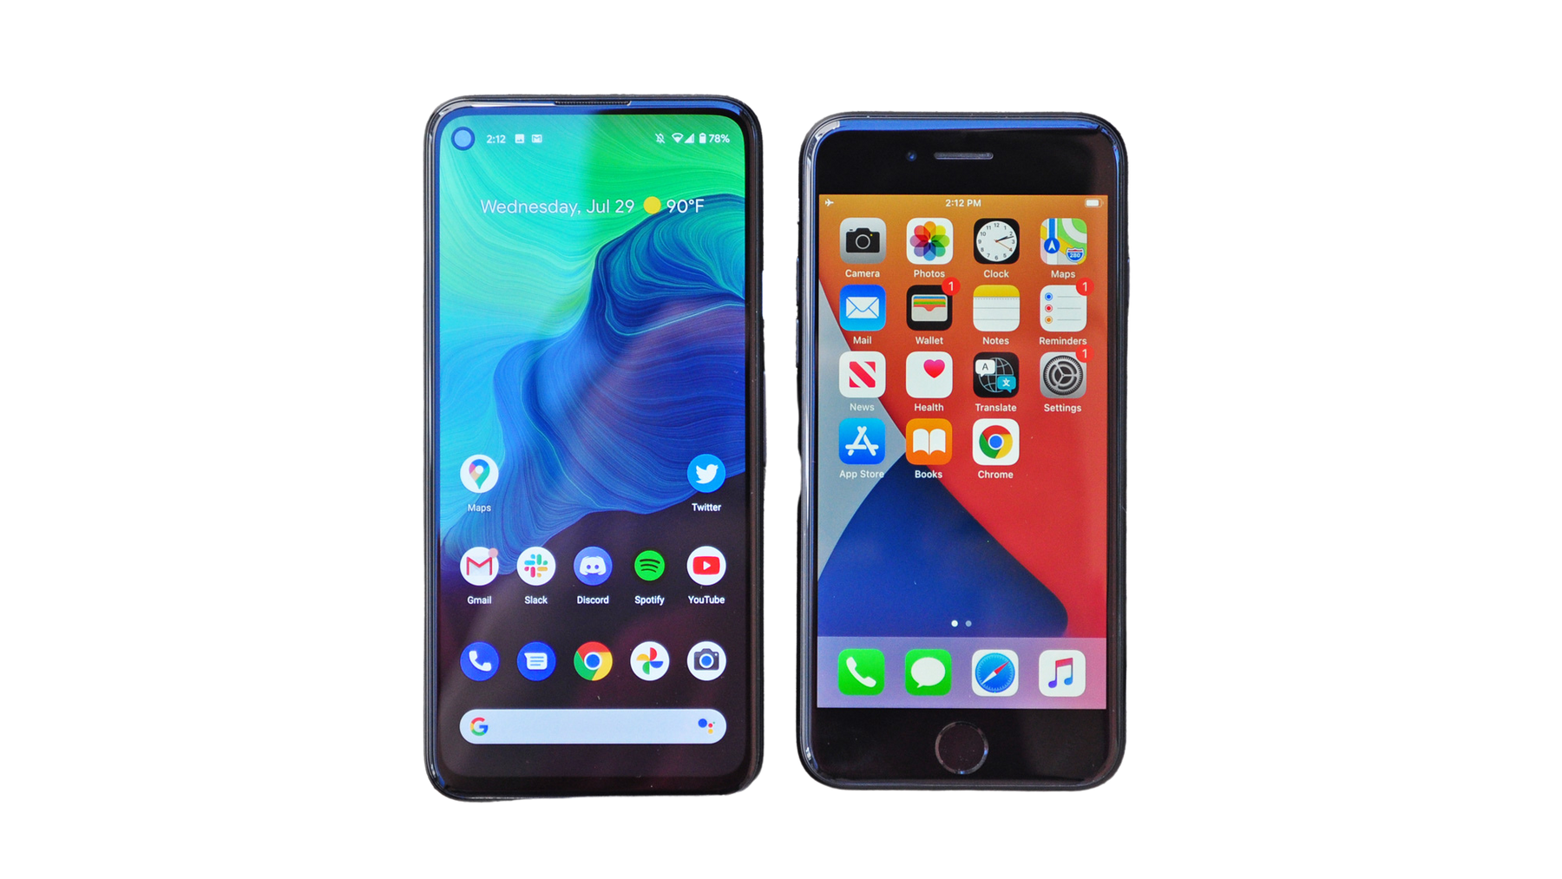
Android vs IOS
Excellent performance optimisation.
High-quality, secure apps in the Apple Store.
Permanent OS updates.
Long-lasting stable performance.
A high degree of user freedom.
Flexibility in interface settings.
Large selection of apps on Play Market.
Lower price.

